Slide 1
DAT 200 – Final Project
Investigating the relationship between death rate, income, and other socioeconomic factors in small cities in America using Linear Regression.
Himasha Karunathilake

Slide 2
Introduction
In this analysis, I will investigate the relationships between independent variables like doctor availability, hospital availability, income, and population density against the dependent variable, death rate. I decided to use this dataset to see primarily how the effect of income would impact the death rate in these small cities. Income is a well-established social determinant of health so investigating its impact on the death rate can help inform policymakers about the importance of allocating resources more effectively to areas where they are most needed (usually low-income areas) and can lead to more funding in preventative healthcare.

Slide 3

The Dataset
Source: The dataset I will be using is from the book “The Rating Guide to Life in America’s Small Cities by G. Scott Thomas” (survey that rates 219 small cities on livability factors)
This dataset compiles various health and socio-economic indicators for different cities. Each indicator is represented by a variable
Independent Variables:
doc_avail: doctor availability per 100,000 residents
hos_avail: hospital availability per 100,000 residents
Income : annual per capita income in thousands of dollars
pop_dens: population density people per square mile
Dependent Variable:
dth_rate : death rate per 100,000 residents
Sample size: n = 53 entries

Slide 4
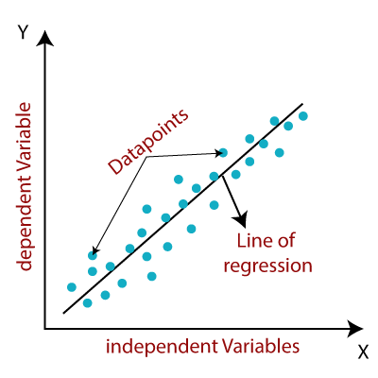
Method of Analysis
I plan to conduct the data analysis utilizing a multiple linear regression model due to the presence of several independent variables. This statistical approach will allow me to explore the relationships and predict the influence of these variables on the dependent variable (death rate). The entire analysis, including the computation and visualization of the results, will be carried out using the R programming environment.

Slide 5
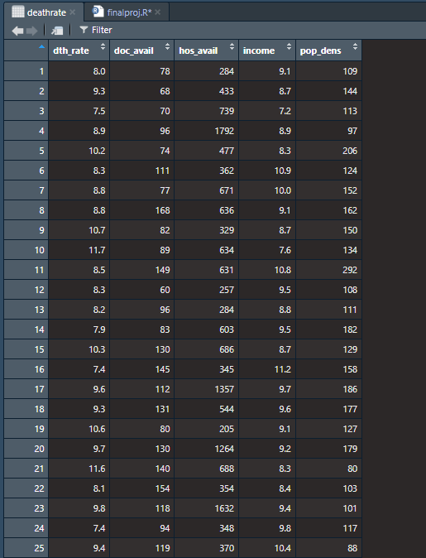
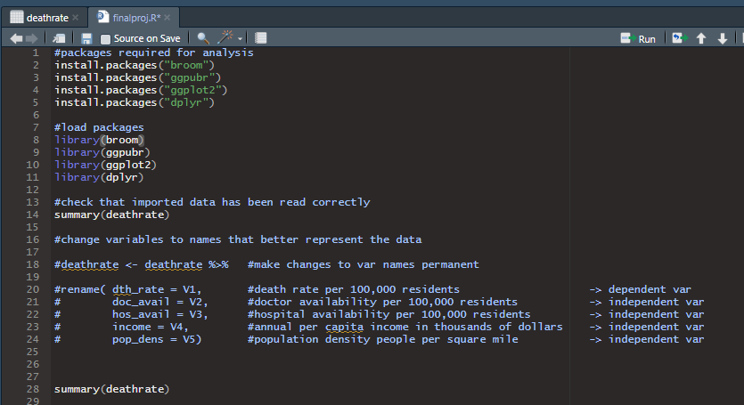
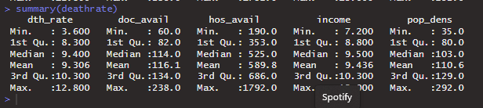
Setup
This R code installs and loads the required packages for the analysis. I have decided to rename the variables into names that better represent the data being investigates
Sample of the dataset (25 entries)

Slide 6
Assumptions for linear regression
Linear regression is a statistical method that models the relationship between variables with a straight line. It identifies the optimal line through the dataset by adjusting the regression coefficient(s) to minimize the model's overall discrepancy.
Linear regression comes in two primary forms:
Simple linear regression, which involves a single independent variable to predict the outcome.
Multiple linear regression, which incorporates two or more independent variables to explain the dependent variable. (This is the form being used for this dataset)
Linear regression is based on four key assumptions that are necessary for the best performance and validity of the model's results:
1) Independence of Observations
2) Normality
3) Linearity
4) Homoscedasticity
I will be checking that the data meets the four assumptions using R.

Slide 7
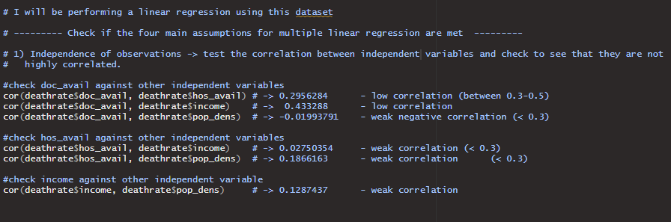
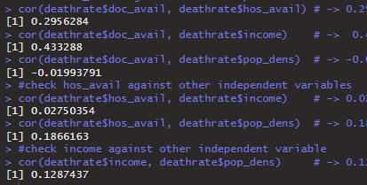
#1) Independence of Observations
This code checks the correlation between each independent variable to check that they are not highly correlated
Low correlation: (doctor availability & death rate), (doctor availability & income)
Weak correlation: (doctor availability & population density), (hospital availability & income), (income & population density)

Slide 8
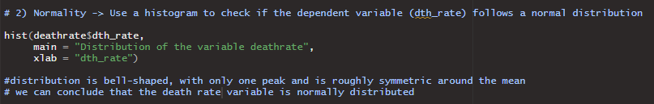
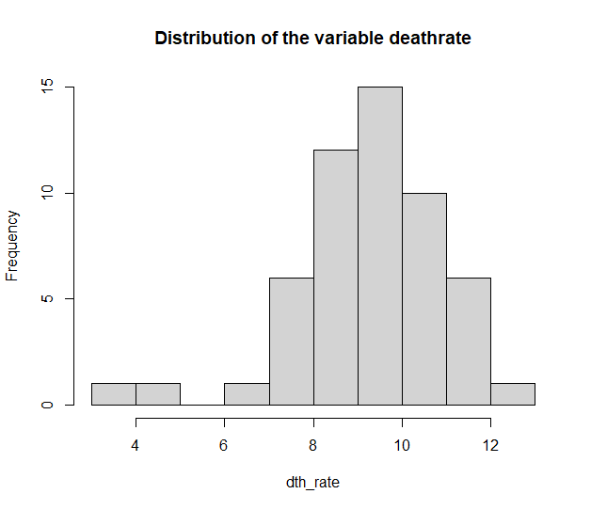
#2) Normality
To check if the dependent variable death rate (dth_rate) follows a normal distribution, I will create a histogram of the variable in R.
The distribution is bell-shamed, has only one peak, and is roughly symmetric around the mean, so we can conclude that the death rate is normally distributed

Slide 9
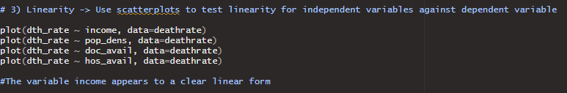
#3) Linearity 1
To check for linearity, I will create scatterplots and see if they show a linear trend.

Slide 10
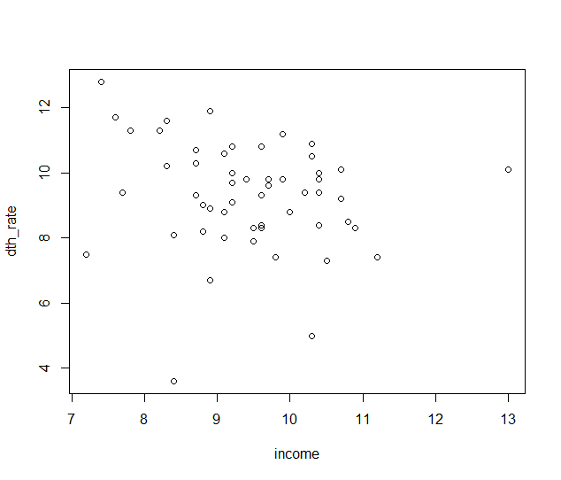
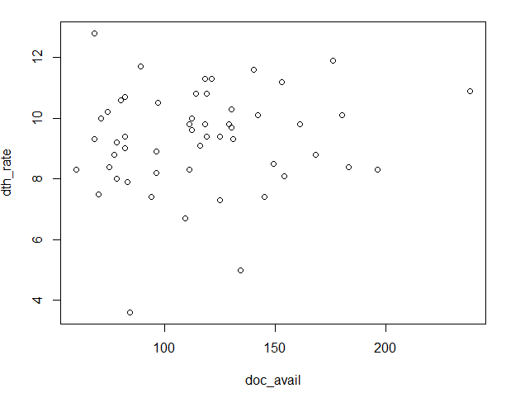
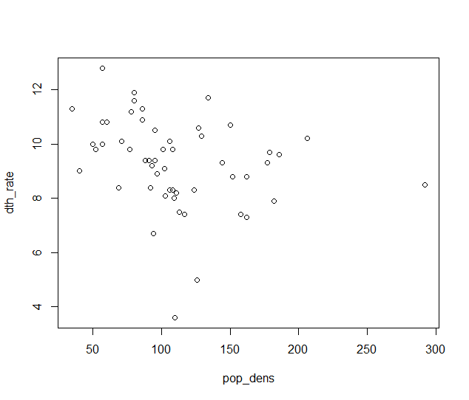
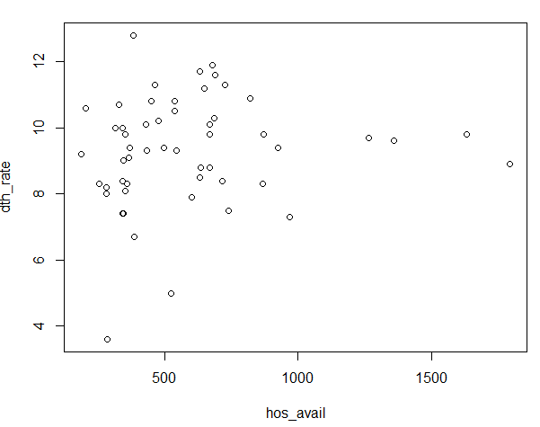
#3) Linearity 2
Results:
Looking at the scatterplots, it seems like the plots income x death rate, and population density x death rate have linear forms
It is more difficult to tell with the variables doctor availability and hospital availability

Slide 11
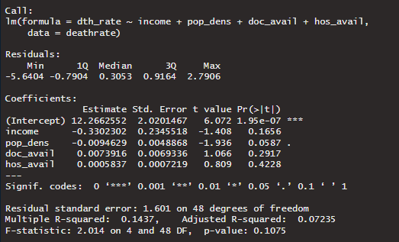
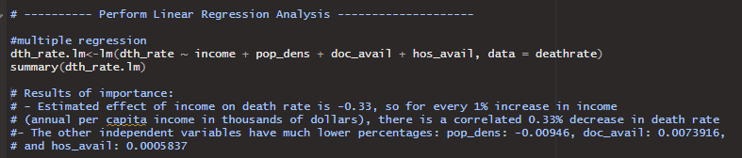
Regression Analysis
I will perform a linear regression analysis to evaluate the relationship between the independent variables and the dependent variables
The results suggest that the estimated effect of income on death rate is -0.33, so for every 1% increase in income (annual per capita income in thousands of dollars), there is a correlated 0.33% decrease in death rate
However, the p-values are significantly high which means the null hypotheses cannot be rejected (I will perform another multiple regression that has a lower p-value for the visualization)

Slide 12

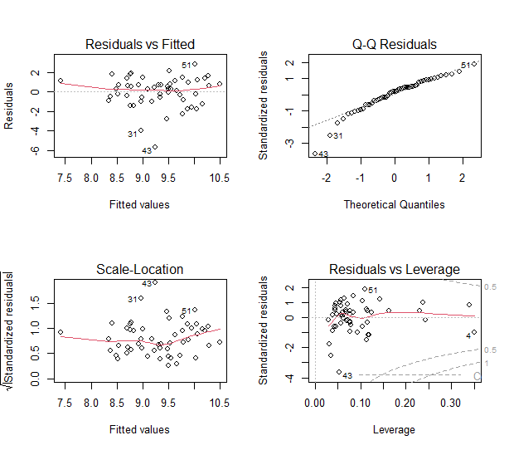
#4) Homoscedasticity
This code helps determine that there is not a large variation in the model error
The mean of residuals (the red lines) are horizontal and centered around zero (there are no biases)
We can conclude that the model fits the assumption of homoscedasticity

Slide 13
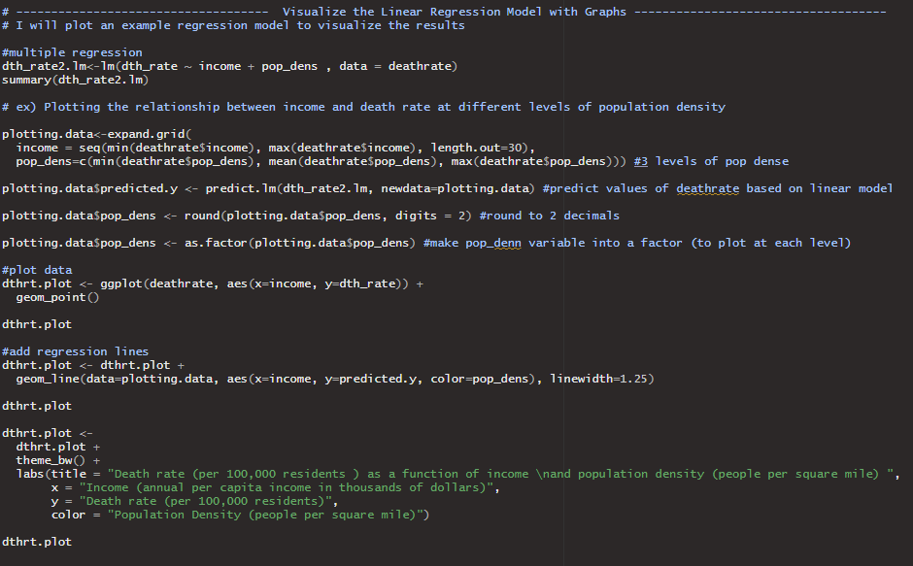
Visualizing the Linear Regression Model with Graphs
To visualize the linear regression model, I will be creating a graph
I will plot the relationship between income and death rate at different levels of population density as an example visualization

Slide 14
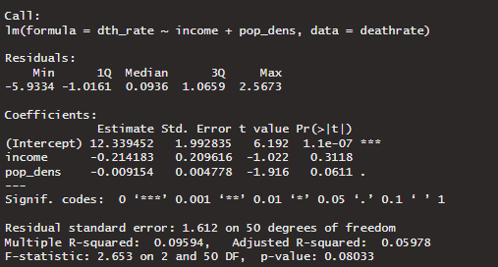
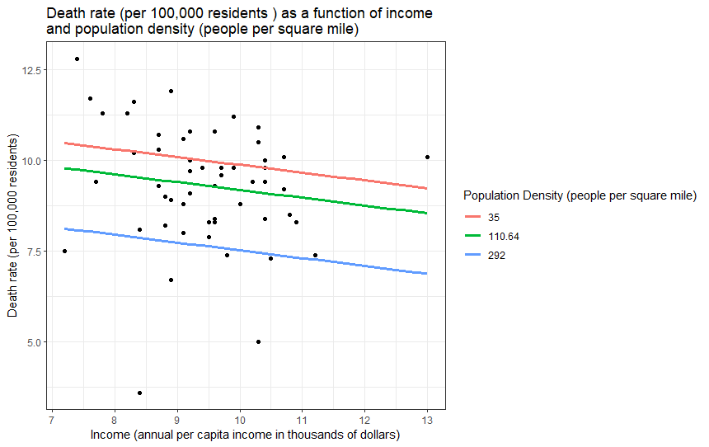
Conclusion
In this dataset with 53 entries, there may be a relationship between the income (annual per capita income in thousands of dollars), death rate (per 100,000 residents), and population density (people per square mile)
Specifically , the results suggest that the estimated effect of income on death rate is -0.21, so for every 1% increase in income (annual per capita income in thousands of dollars), there is a correlated 0.21% decrease in death rate
The results also suggest that that the estimated effect of population density on death rate is -0.0092, so for every 1% increase in population density (people per square mile), there is a correlated 0.0092 % decrease in death rate

Slide 15
Limitations
One of the constraints encountered in this data analysis was the limited sample size. An expanded dataset with a greater number of observations would likely yield more definitive results.
Specifically, the assessment of linearity between variables such as doctor availability, hospital availability, and death rate proved challenging. With access to a larger pool of data for evaluation, the determination of a linear relationship might have been more straightforward and clearer in the scatterplots.
Similarly, with a larger dataset, the regression analysis could have revealed a more defined relationship between the death rate and the independent variables.

Slide 16
Appendix 1
Full source-code (Appendix 1 – 4):
#packages required for analysis install.packages("broom") install.packages("ggpubr") install.packages("ggplot2") install.packages("dplyr") #load packages library(broom) library(ggpubr) library(ggplot2) library(dplyr) #check that imported data has been read correctly summary(deathrate) #change variables to names that better represent the data #deathrate <- deathrate %>% #make changes to var names permanent #rename( dth_rate = V1, #death rate per 100,000 residents -> dependent var # doc_avail = V2, #doctor availability per 100,000 residents -> independent var # hos_avail = V3, #hospital availability per 100,000 residents -> independent var # income = V4, #annual per capita income in thousands of dollars -> independent var # pop_dens = V5) #population density people per square mile -> independent var summary(deathrate)

Slide 17
Appendix 2
# I will be performing a linear regression using this dataset # --------- Check if the four main assumptions for multiple linear regression are met --------- # 1) Independence of observations -> test the correlation between independent variables and check to see that they are not # highly correlated. #check doc_avail against other independent variables cor(deathrate$doc_avail, deathrate$hos_avail) # -> 0.2956284 - low correlation (between 0.3-0.5) cor(deathrate$doc_avail, deathrate$income) # -> 0.433288 - low correlation cor(deathrate$doc_avail, deathrate$pop_dens) # -> -0.01993791 - weak negative correlation (< 0.3) #check hos_avail against other independent variables cor(deathrate$hos_avail, deathrate$income) # -> 0.02750354 - weak correlation (< 0.3) cor(deathrate$hos_avail, deathrate$pop_dens) # -> 0.1866163 - weak correlation (< 0.3) #check income against other independent variable cor(deathrate$income, deathrate$pop_dens) # -> 0.1287437 - weak correlation
# 2) Normality -> Use a histogram to check if the dependent variable (dth_rate) follows a normal distribution
hist(deathrate$dth_rate,
main = "Distribution of the variable deathrate",
xlab = "dth_rate")
#distribution is bell-shaped, with only one peak and is roughly symmetric around the mean
# we can conclude that the death rate variable is normally distributed
# 3) Linearity -> Use scatterplots to test linearity for independent variables against dependent variable
plot(dth_rate ~ income, data=deathrate)
plot(dth_rate ~ pop_dens, data=deathrate)
plot(dth_rate ~ doc_avail, data=deathrate)
plot(dth_rate ~ hos_avail, data=deathrate)
#The variable income appears to a clear linear form

Slide 18
Appendix 3
# ---------- Perform Linear Regression Analysis --------------------
#multiple regression
dth_rate.lm<-lm(dth_rate ~ income + pop_dens + doc_avail + hos_avail, data = deathrate)
summary(dth_rate.lm)
# Results of importance:
# - Estimated effect of income on death rate is -0.33, so for every 1% increase in income
# (annual per capita income in thousands of dollars), there is a correlated 0.33% decrease in death rate
#- The other independent variables have much lower percentages: pop_dens: -0.00946, doc_avail: 0.0073916,
# and hos_avail: 0.0005837
# 4) Check for homoscedasticity -> check that there is not a large variation in the model error
par(mfrow=c(2,2))
plot(dth_rate.lm)
par(mfrow=c(1,1))
# result: mean of residuals (red line) are horizontal and centered around zero (no biases)
# so, the model fits the assumption of homoscedasticity

Slide 19
Appendix 4
# ------------------------------------ Visualize the Linear Regression Model with Graphs ------------------------------------
# I will plot an example regression model to visualize the results
#multiple regression
dth_rate2.lm<-lm(dth_rate ~ income + pop_dens , data = deathrate)
summary(dth_rate2.lm)
# ex) Plotting the relationship between income and death rate at different levels of population density
plotting.data<-expand.grid(
income = seq(min(deathrate$income), max(deathrate$income), length.out=30),
pop_dens=c(min(deathrate$pop_dens), mean(deathrate$pop_dens), max(deathrate$pop_dens))) #3 levels of pop dense
plotting.data$predicted.y <- predict.lm(dth_rate2.lm, newdata=plotting.data) #predict values of deathrate based on linear model
plotting.data$pop_dens <- round(plotting.data$pop_dens, digits = 2) #round to 2 decimals
plotting.data$pop_dens <- as.factor(plotting.data$pop_dens) #make pop_denn variable into a factor (to plot at each level)
#plot data
dthrt.plot <- ggplot(deathrate, aes(x=income, y=dth_rate)) +
geom_point()
dthrt.plot
#add regression lines
dthrt.plot <- dthrt.plot +
geom_line(data=plotting.data, aes(x=income, y=predicted.y, color=pop_dens), linewidth=1.25)
dthrt.plot
dthrt.plot <-
dthrt.plot +
theme_bw() +
labs(title = "Death rate (per 100,000 residents ) as a function of income \nand population density (people per square mile) ",
x = "Income (annual per capita income in thousands of dollars)",
y = "Death rate (per 100,000 residents)",
color = "Population Density (people per square mile)")
dthrt.plot

